Slide 1

Property, Plant & Equipment Part 1 - Video

Slide 2
Property, Plant & Equipment (PPE)
Operational
Actively used in operations
Expected to provide benefits beyond the current accounting period
Has physical substance
Generally reported as property, plant, and equipment; plant assets; or fixed assets
Long-Term
Tangible
Notes:
PP&E: part of an Asset Class considered Tangible, Operational Assets with long-term benefits.

Slide 3
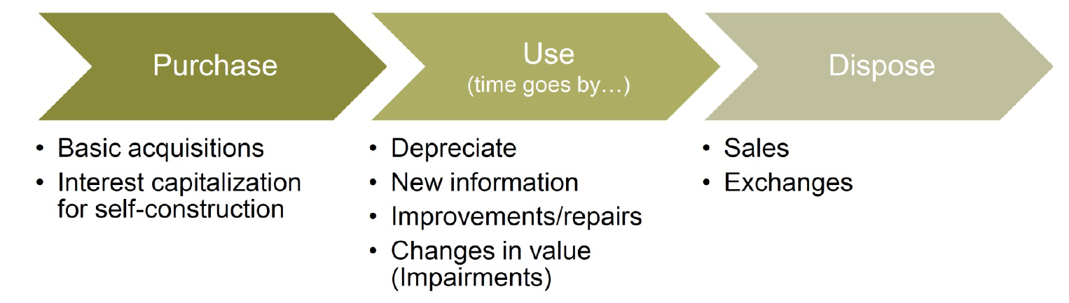
PP&E Life Cycle

Slide 4
Determining acquisition cost
Historical cost = price of obtaining the asset (capitalize)
+ any costs of bringing it to the location
+ any costs necessary for its intended use.
Notes:
Largely the same as inventory or other tangible assets: USE HISTORICAL COST:
Why? Its Reliable.
We’re not going to use fair value because Companies should not anticipate gains/losses. But should recog Gain/loss only when the asset is sold.
Note that attorney costs in the acquisition are capitalized (HW2).
Removing old building goes to getting LAND ready for use, not the future bldg. that may go up
Salvaged materials: if you are able to sell the bricks or copper (pipes) salvaged on your land, you DR Cash and CR Land (to reduce cost of land)
NOTE: improvements with limited lives are recorded separately as Land Improvements and depreciated over their estimated lives

Slide 5
Determining acquisition cost
Land (not depreciable)
Purchase price
Real estate commissions
Attorney’s fees
Title search
Title transfer fees
Title insurance premiums
Removing old buildings
Land Improvements
Separately identifiable
costs of
Driveways
Parking lots
Fencing
Landscaping
Private roads
Yes, Depreciated!
Notes:
Largely the same as inventory or other tangible assets: USE HISTORICAL COST:
Why? Its Reliable.
We’re not going to use fair value because Companies should not anticipate gains/losses. But should recog Gain/loss only when the asset is sold.
Note that attorney costs in the acquisition are capitalized (HW2).
Removing old building goes to getting LAND ready for use, not the future bldg. that may go up
Salvaged materials: if you are able to sell the bricks or copper (pipes) salvaged on your land, you DR Cash and CR Land (to reduce cost of land)
NOTE: improvements with limited lives are recorded separately as Land Improvements and depreciated over their estimated lives

Slide 6
Determining acquisition cost
Equipment
Net purchase price
Taxes
Transportation costs
Installation costs
Modification to building necessary to install equipment
Testing and trial runs
Buildings
Purchase price
Attorney’s fees
Commissions
Reconditioning
Delinquent Taxes
Notes:
Any modifications necessary to fit equipment into a particular room, for example
And
Any money spent on Testing and trial runs also gets Capitalized : booked to the asset …. To be depreciated over its life and NOT expensed immediately

Slide 7
Do Not Capitalize
Interest incurred on debt to purchase plant assets because the asset is already in its intended condition for use.
Cost of training employees (improves employee value, not the asset)
Annual insurance costs or property taxes – these maintain the asset
Ordinary repairs

Slide 8
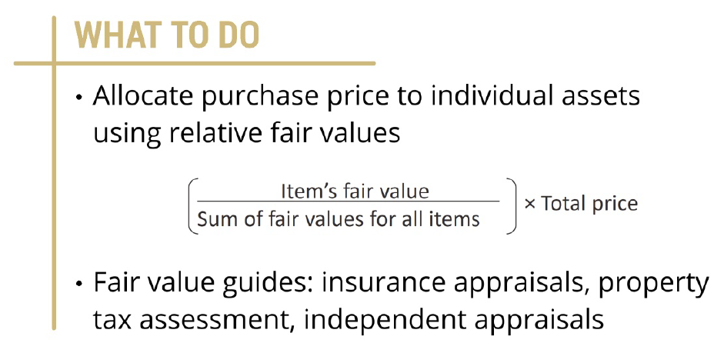
Lump Sum Purchase
Acquire multiple fixed assets for a single price.

Slide 9
Lump Sum Purchase
The negotiated acquisition price paid for land, a storage facility, and machinery for a purchase on December 1 is $90,000.
These assets are individually appraised as follows:
Land, $30,000
Storage facility, $50,000
Machinery, $20,000
Our Task: Allocate the single lump-sum price using the proportional method.

Slide 10
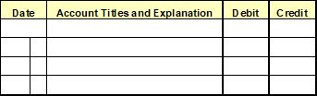
Lump Sum Purchase
Asset | Appraised Value | % of Value | Total Price | Assigned Cost
Land | $ 30,000 | 30/100 = .3 | 90,000 | $ 27,000
Storage facility | 50,000 | 50/100 = .5 | 90,000 | 45,000
Machinery | 20,000 | 20/100 = .2 | 90,000 | 18,000
 | $100,000 |  |  | $ 90,000
Amounts for Journal entry
Land 27,000
Storage facility 45,000
Machinery 18,000
Cash 90,000

Slide 11
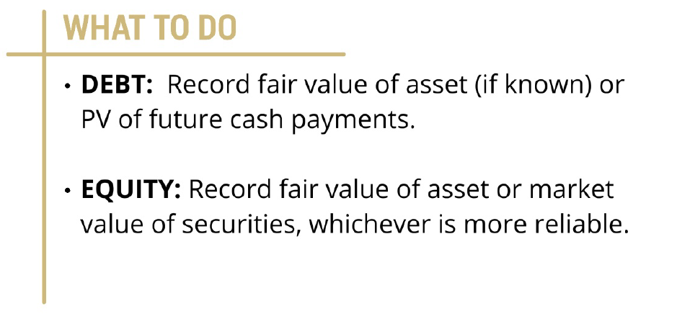
Purchase using Debt or Equity
Pay with a note payable or shares of equity

Slide 12
Purchase using Debt or Equity
Example: Jafar Enterprises purchases equipment on 1/1 in exchange for a $9,000 non-interest bearing note that is due in two years. The prevailing interest rate is 8% for liabilities of similar risk and duration. At the date of acquisition, what value should the equipment be recorded at on the balance sheet?
Scenario 1: Fair value of asset is $7,000.
Answer: Record at $7,000

Slide 13
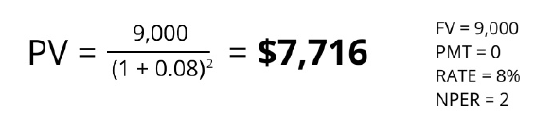
Purchase using Debt or Equity
Example: Jafar Enterprises purchases equipment on 1/1/ in exchange for a $9,000 non-interest bearing note that is due in two years. The prevailing interest rate is 8% for liabilities of similar risk and duration. At the date of acquisition, what value should the equipment be recorded at on the balance sheet?
Scenario 1: Fair value of asset is unknown.
Answer:

Slide 14
Closing Thoughts
Property, plant, and equipment are tangible assets used in operations.
Always record PP&E at historical cost (acquisition cost) on the balance sheet
If purchased in a lump sum, allocate using fair values
Be careful to record PP&E at appropriate values if purchased using debt or equity.

Slide 15
Property, Plant & Equipment Part 1 - Video

